Slide 1
ITWB2914 · MINOR PROJECT · FAIFT, UNITAR INTERNATIONAL UNIVERSITY
Enhancing Event Logistics Efficiency Through an Integrated Real-Time Tent and Equipment Allocation Framework
Dhinesh Raj A/L Philip Jason
MC231025222
Bachelor of Information Technology
Supervisor: Assoc. Prof. Dr. Fakhrul Hazman Yusoff

Slide 2
1,000+
AR Events Sdn. Bhd.
RENTABLE ASSETS
A medium-sized event rental business in Bandar Sunway, Petaling Jaya. Canopies, tables, chairs, cooler and decor for weddings, kenduri, corporate functions and more — coordinated entirely from a list on the owner's phone.
4
WORKERS
BOOKING CHANNELS
Instagram DM
WhatsApp
Phone
Walk-in
Referral
30 / 128 / 800
CANOPIES / TABLES / CHAIRS
2

Slide 3
PROBLEM STATEMENT
Five blind spots in a thousand-asset business
1
No real-time availability
Availability is judged from memory during a live customer call — a refusal can't be verified against any record.
2
No cost or profit visibility
Revenue is on the invoice; cost is never allocated to the event that caused it. Pricing decisions have no financial evidence behind them.
3
Reactive loss & damage
Missing or damaged items surface only at dismantling, dependent entirely on whoever is on-site that day.
4
Untracked wage liabilities
No record ties a worker to a job and a settlement. Outstanding pay is kept informally.
5
Unverified seasonality
Busy and slow months are the owner's recollection, never checked against structured historical data.
3

Slide 4
AIM & OBJECTIVES
From memory-based decisions to a verifiable record
Give the owner accurate, asset-level equipment availability across concurrent bookings, and quantified visibility of the cost, revenue and profit each event generates.
01
02
Understand current practice
Real-time allocation model
Document booking, allocation, labour and record-keeping directly with the owner.
Track asset-level availability across overlapping windows of occupancy.
03
04
Cost & revenue data structure
Analytics & dashboard
Capture cost, labour and revenue per event to compute per-event profit.
Quantify seasonal demand and surface daily / weekly / monthly profit.
4

Slide 5
PROJECT SCOPE
A design specification, not a working system
IN SCOPE
OUT OF SCOPE
Requirements gathering from the owner
Functional & non-functional requirements
Use case model & data flow diagrams
Feasibility study (5 dimensions)
Database design (ER diagram)
System architecture & interface design
Analytical approach for demand & profit
Coding, implementation & deployment
Unit, integration & acceptance testing
Third-party payment / accounting integration
Automated worker scheduling or routing
Direct customer-facing booking
Payroll processing
Financial audit of historical accounts
5

Slide 6
LITERATURE REVIEW
The research gap this project occupies
Inventory Tracking in SMEs
Real-Time Allocation
Oyetade et al. (2024); Panigrahi et al. (2024)
Teerasoponpong & Sopadang (2022)
Tracking is a distinct, measurable driver of SME performance — separate from storage and control.
Decision support for SMEs is feasible — but existing work targets replenishment, not recovery-based rental cycles.
Seasonal Forecasting
BI Dashboards for SMEs
Borucka (2023); Tadayonrad & Ndiaye (2023)
Gonçalves et al. (2023); Alsibhawi et al. (2023)
Interpretable methods work with modest historical data — complexity doesn't reliably beat simplicity.
Adoption depends on ease of use and information quality more than analytical power.
6

Slide 7
METHODOLOGY
Waterfall, chosen against the alternatives
Agile
Prototyping
Waterfall
REJECTED
USED WITHIN DESIGN
SELECTED
No working software to react to within minor-project scope; one stakeholder, not a product team.
Mockups surfaced the wage-settlement requirement — but broad iteration wasn't needed once requirements stabilised.
Single stakeholder, sequentially dependent deliverables, and alignment with the chapter-by-chapter reporting structure.
7

Slide 8
KEY FINDING
One event occupies stock for three days, not one
Equipment is dispatched the day before an event and dismantled the day after. Availability is therefore a problem of overlapping intervals — not matching dates.
13 Jun
14 Jun (Event)
15 Jun
16 Jun (Event)
17 Jun
Booking A — window
Booking B — window
Same physical stock is claimed by both bookings on 15 June — even though the two event dates never touch.
ITWB2914 Minor Project — AR Events Allocation Framework
8

Slide 9
SYSTEM DESIGN
A three-tier architecture, sized for one user
PRESENTATION TIER
Responsive web app in the owner's mobile browser — no app-store install, no dedicated hardware.
Dashboard
Availability
Booking entry
Costs & labour
APPLICATION TIER
Server-side booking, allocation, quoting and invoicing logic. Analytics run on a schedule, not per request.
Authentication
Allocation engine
Quote & cost engine
Scheduled analytics
DATA TIER
Relational database enforcing integrity across bookings, allocations and labour — 12 entities.
Relational DB
Scheduled backup
8

Slide 10
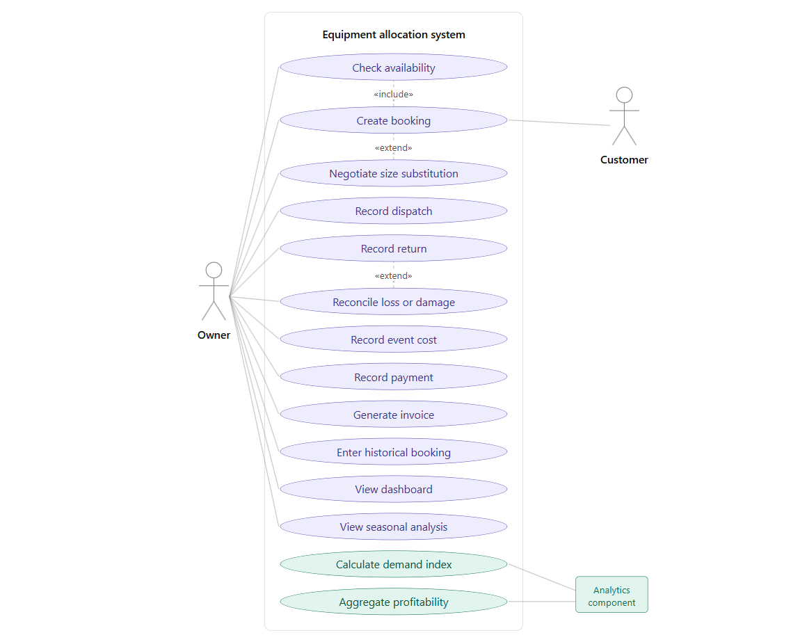
DATABASE DESIGN
Use Case Diagram
9

Slide 11
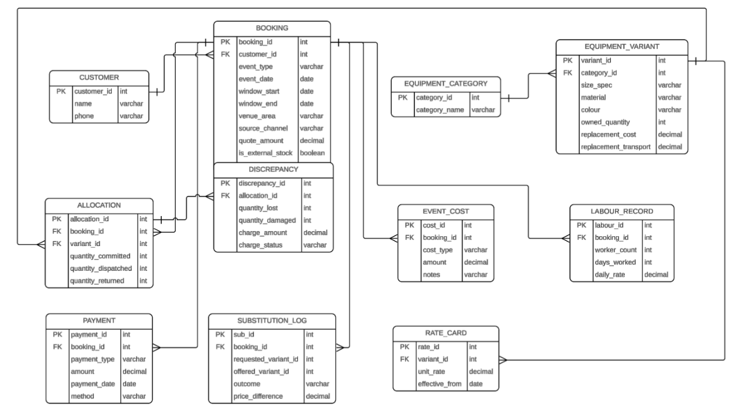
DATABASE DESIGN
Entity-Relationship Diagram ( ERD)
9

Slide 12
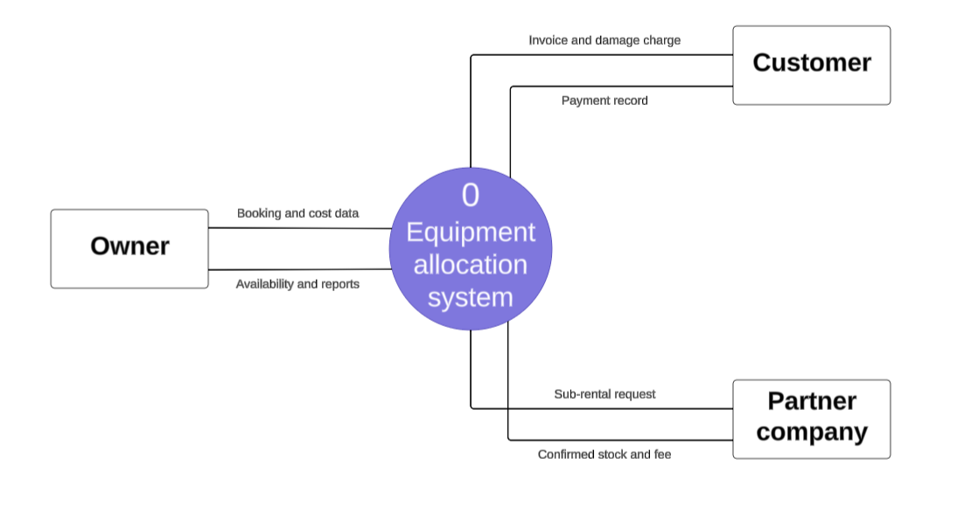
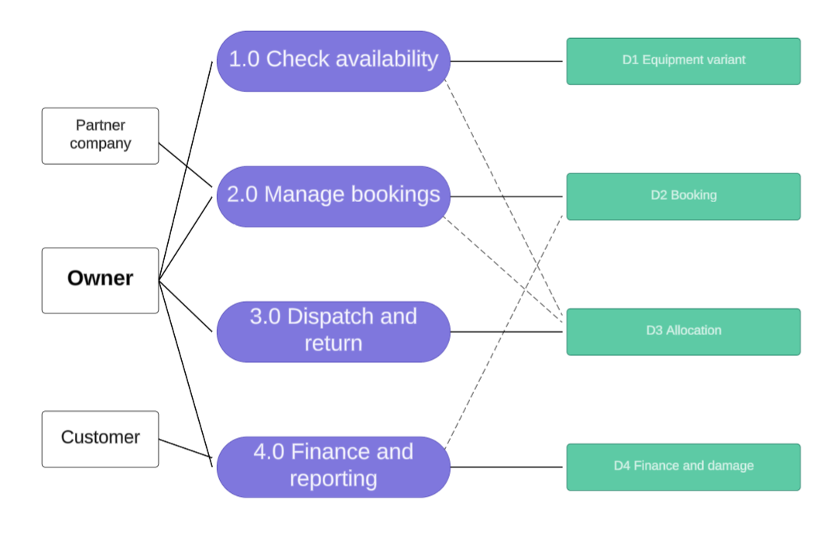
DATABASE DESIGN
Data Flow Diagram
DFD Level 1
DFD Level 0
9

Slide 13
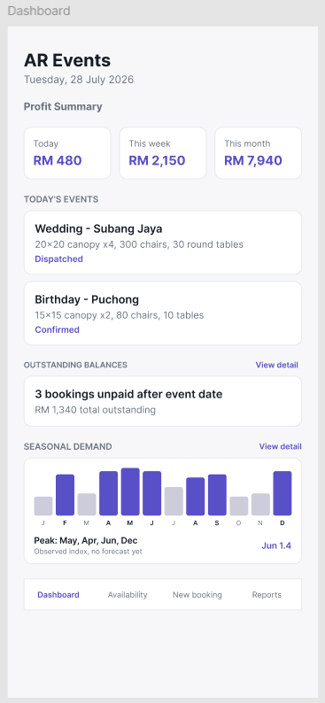
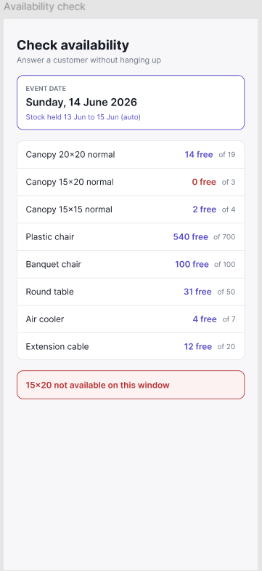
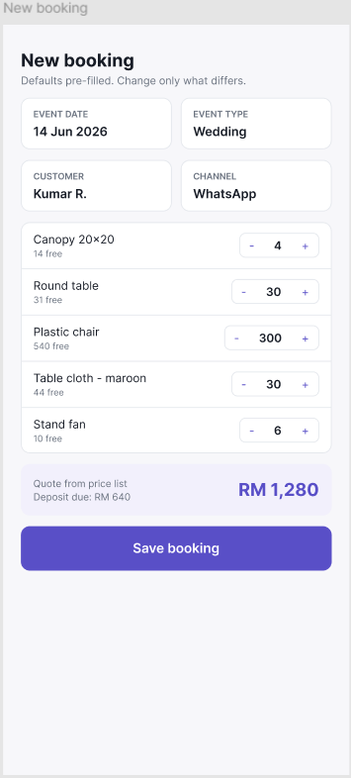
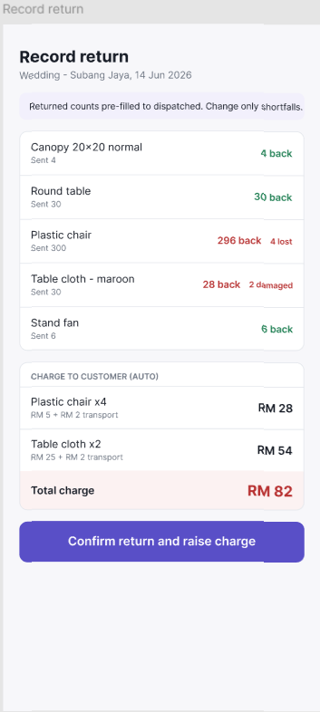
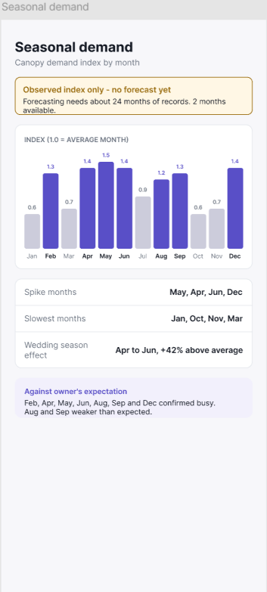
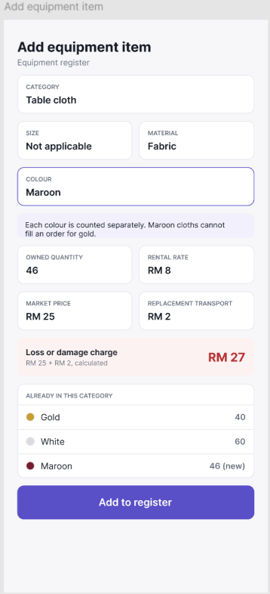
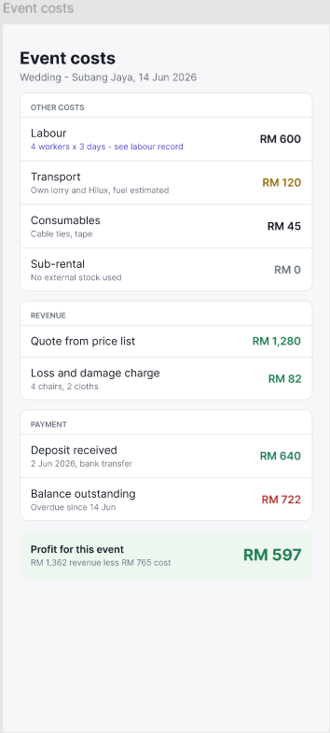
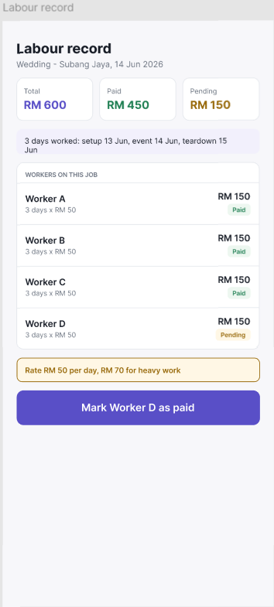
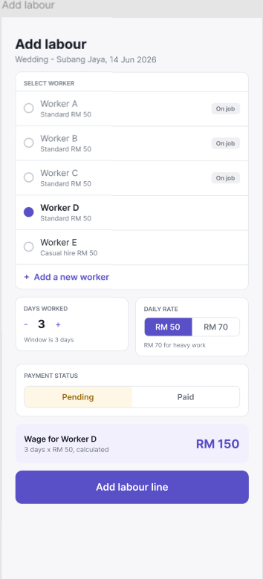
INTERFACE DESIGN
Mock-up Interfaces
Dashboard
Availability
New Booking
Record Return
Seasonal Demand
Add Equipment
Event Costs
Labour Record
Add Labour
10

Slide 14
INTERFACE DESIGN
Mock-up Interfaces
New Booking
Record Return
Seasonal Demand
Add Equipment
Event Costs
Labour Record
Add Labour
Dashboard
Availability
10

Slide 15
Thank You
Questions & Answers
11

